Slide 1
AI BASED PHISHING ATTACK DETECTION
Presented By, | Under the guidance of, Guide Name Designation Department of CSE, EPCET
Name(USN)
Name(USN)
Name(USN)
Name(USN)

Slide 2
Introduction
In today's digital era, phishing attacks pose a significant threat to online security. Our project, AI-Based Phishing Attack Detection, leverages machine learning to identify malicious URLs effectively. By analyzing features such as URL length, special character counts, and other parameters, our system predicts whether a URL is benign or malicious.
Deployed on Flask, it provides users with an intuitive interface for real-time URL analysis, complemented by a Plotly-powered dashboard for data visualization. PostgreSQL serves as the robust backend for data storage and management, ensuring scalability and reliability.

Slide 3
Problem Statement
Phishing attacks have become one of the most prevalent cybersecurity threats, targeting individuals and organizations by deceiving users into revealing sensitive information such as passwords, credit card details, and personal data. With phishing techniques constantly evolving, traditional detection methods struggle to keep up, leading to significant financial and reputational damages.
The lack of real-time, scalable solutions exacerbates the problem, leaving users vulnerable to these sophisticated attacks. There is an urgent need for an intelligent, automated system that leverages machine learning to analyze URL features, detect phishing attempts with high accuracy, and provide actionable insights to enhance online security.

Slide 4
Literature Survey
Author | Title | Year | Description | Metrics | Demerits
Verma & Akbar | A Framework for Phishing Detection Using URL Features | 2020 | Proposed a model to detect phishing using URL-based features, employing machine learning techniques. | Accuracy: 92.5%, Precision: 90% | Limited feature set; struggles with new phishing tactics.
Basnet et al. | Phishing Detection Using Machine Learning | 2015 | Utilized various machine learning algorithms to identify phishing websites based on feature analysis. | Detection Rate: 94%, F1-Score: 0.91 | High false positive rate; lacks real-time processing capability.

Slide 5
James et al. | Intelligent Phishing Website Detection Model | 2018 | Combined lexical features of URLs and page content to build a hybrid phishing detection system. | Recall: 93%, Accuracy: 91% | Computationally intensive due to feature extraction from page content; slower real-time performance.
Sahingoz et al. | Feature-Rich Machine Learning Model for Phishing Detection | 2019 | Proposed a rich feature set including URL structure, domain analysis, and word embeddings for phishing detection. | Accuracy: 95.4%, Precision: 94% | Complex model increases processing time; requires extensive data preprocessing.
Zhang & Zhang | Real-Time Phishing Detection System | 2021 | Focused on building a real-time, lightweight phishing detection mechanism using URL heuristics. | Response Time: < 1 sec, Accuracy: 90% | Lower accuracy in detecting highly sophisticated phishing attempts; limited feature generalization.

Slide 6
Existing System
Existing System Currently, phishing detection primarily relies on blacklist-based, heuristic-based, and manual reporting systems.
Blacklist-Based Detection: Maintains a database of known phishing URLs and flags any matches.
Heuristic-Based Detection: Uses predefined rules to analyze URLs, content, and other attributes for phishing characteristics.
Manual Reporting: Relies on users to identify and report phishing sites.
Limitations
Blacklist-Based Detection:
Ineffective against new or unlisted phishing URLs.
Requires constant database updates, which may not happen in real-time.
Heuristic-Based Detection:
Static rules struggle to keep up with dynamic and polymorphic phishing tactics.
Higher false-positive rates due to reliance on rigid patterns.
Manual Reporting:
Time-consuming and prone to human error.
Delayed response, as phishing sites might remain active during reporting and verification processes.

Slide 7
Proposed System
The proposed system employs a machine learning-based approach to detect phishing attacks by analyzing URL features such as special characters ('@', '%', '='), URL length, and domain attributes. Deployed as a Flask application, it allows users to input URLs for real-time prediction and provides a dynamic Plotly-powered dashboard for data visualization. PostgreSQL ensures robust and scalable backend support.
Advantages
Real-Time Detection: Instant prediction of malicious URLs.
High Accuracy: Enhanced detection using machine learning.
Feature-Rich Analysis: Robust against novel phishing techniques.
Scalability: Reliable data storage with PostgreSQL.
User-Friendly Interface: Intuitive application and dashboard.
Data Visualization: Insights through Plotly-powered charts.
Reduced False Positives: Improved reliability compared to traditional methods.

Slide 8
Aim of the Project
The aim of this project is to develop an AI-Based Phishing Attack Detection System that utilizes machine learning to analyze URL features and accurately classify them as benign or malicious. The system aims to provide:
Real-Time Detection: Efficiently identify phishing attempts to enhance user security.
Automated Feature Extraction: Analyze URL parameters to detect sophisticated phishing tactics.
User-Friendly Interface: Enable seamless interaction through a Flask web application.
Visual Insights: Offer data visualization with Plotly to track and analyze user inputs.
Scalable Backend: Leverage PostgreSQL for reliable data storage and management.

Slide 9
Objectives
Develop an Intelligent Detection System
Build a machine learning model to classify URLs as benign or malicious based on key features.
Real-Time URL Analysis
Create a system capable of extracting and analyzing URL features in real-time.
User-Friendly Application
Design a Flask-based web interface for seamless user interaction and input processing.
Data Visualization
Integrate a Plotly-powered dashboard to visualize user inputs and detection trends effectively.
Scalable and Reliable Backend
Implement PostgreSQL for robust data storage and efficient query handling.
Enhance Cybersecurity Awareness
Provide insights into phishing patterns and contribute to proactive security measures.

Slide 10
System Architecture
1. User Interface (Flask Web Application)
Users input a URL for analysis.
Provides real-time results on whether the URL is benign or malicious.
2. Feature Extraction Module
Extracts relevant features from the input URL, such as:
Presence of special characters ('@', '%', '=').
URL length and domain attributes.
Prepares data for the machine learning model.
3. Machine Learning Model
Trained on a dataset of phishing and benign URLs.
Predicts the likelihood of a URL being malicious based on extracted features.

Slide 11
4. Backend (PostgreSQL Database)
Stores user inputs, predictions, and system logs for future reference and analysis.
Ensures data reliability and scalability for large-scale operations.
5. Data Visualization (Plotly Dashboard)
Visualizes input trends, such as common phishing URL patterns and detection statistics.
Provides insights into system usage and phishing trends over time.
6. Interaction Flow
Step 1: User inputs a URL through the web interface.
Step 2: Feature extraction module processes the URL.
Step 3: Processed data is passed to the machine learning model for prediction.
Step 4: Prediction results are displayed on the web interface.
Step 5: Input and results are stored in the PostgreSQL database.
Step 6: Dashboard visualizes the collected data and trends.

Slide 12
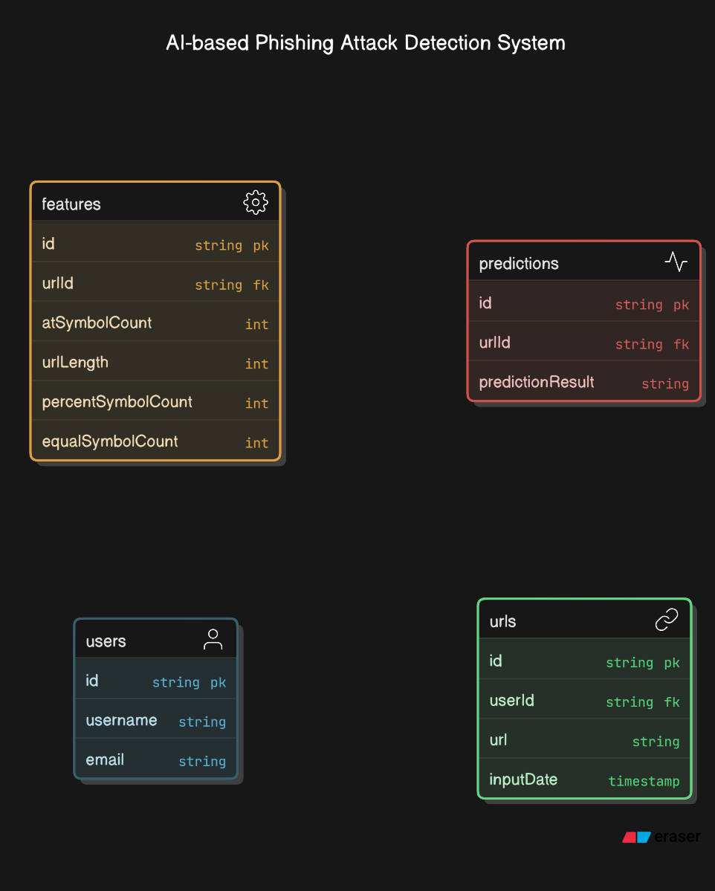
System Design
ER Diagram

Slide 13
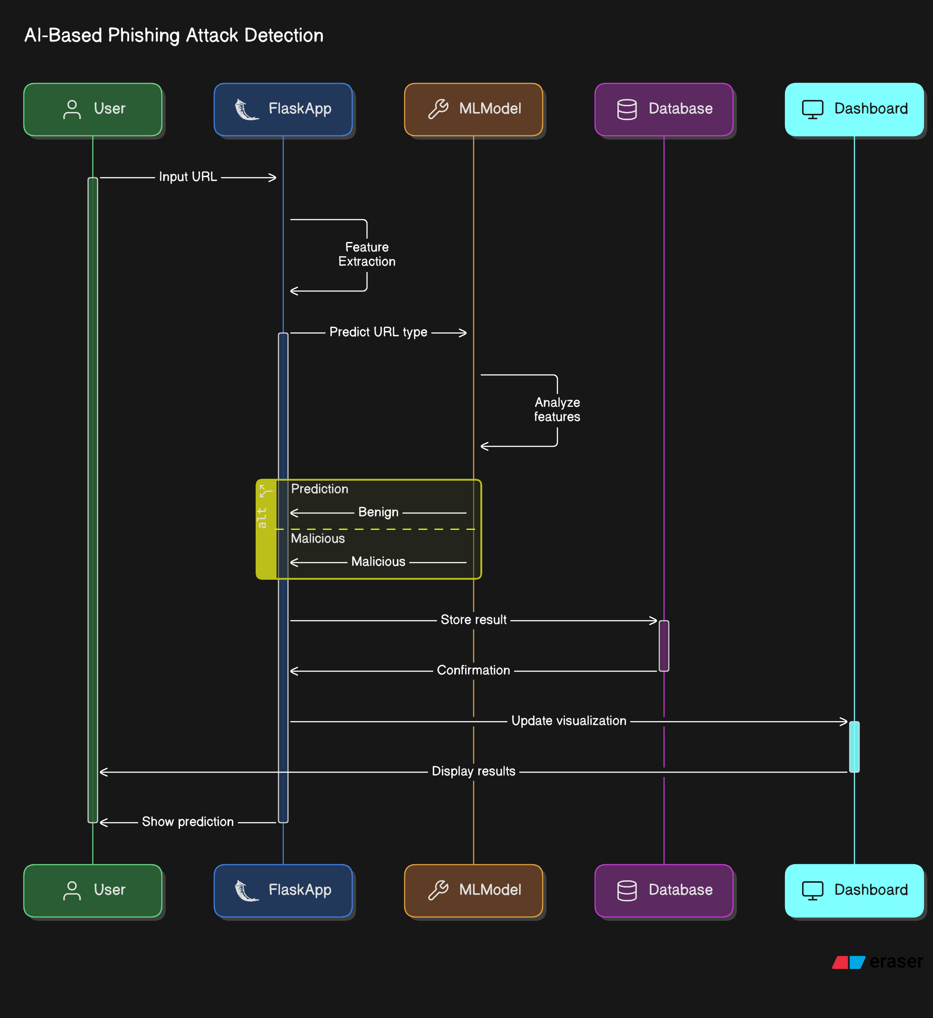
Sequence Diagram

Slide 14
Hardware and Software Requirements
Software Requirements
Programming Languages:
Python 3.7 or higher
Libraries & Frameworks:
Flask: Web framework for developing the user interface and API.
scikit-learn: For building and training machine learning models.
Pandas: For data handling and preprocessing.
NumPy: For numerical computations.
Plotly: For data visualization in the dashboard.
SQLAlchemy: ORM tool for interacting with the PostgreSQL database.
PostgreSQL: Relational database management system for storing data.
Development Tools:
Anaconda/Virtual Environment: To manage dependencies.
Jupyter Notebook: For model development and testing.
VS Code or PyCharm: For coding and development.
Version Control:
Git: For source code management.
Operating System:
Windows, macOS, or Linux

Slide 15
Hardware Requirements
Processor:
Intel Core i3/i5/i7 or equivalent.
RAM:
Minimum 4GB, recommended 8GB or higher.
Storage:
At least 20GB of free space for storing datasets, application files, and logs.
Internet Connectivity:
For downloading libraries, hosting the Flask app, and accessing remote databases if required.
Additional Hardware (Real-Time):
Web Server: For hosting the Flask application in a production environment (e.g., Apache or Nginx).
Backup Storage: For database and application data backups.

Slide 16
System Implementation
1. User Interface Module (Flask Web Application)
Objective: Provide a web interface for users to input URLs and view results.
Description: Users input a URL, which is processed by the backend, and the prediction (benign or malicious) is displayed.
Algorithm:
Receive user input.
Pass URL to the Feature Extraction Module for processing.
Display prediction result from the Machine Learning Model.
2. Feature Extraction Module
Objective: Extract relevant features from URLs to prepare them for machine learning models.
Description: Features such as URL length, special characters, subdomain count, and domain suspicion are extracted.
Algorithm:
Extract URL length, special characters count, subdomain count, and check domain suspicion.
Return extracted features for prediction.

Slide 17
3. Machine Learning Model
Objective: Classify the URL as benign or malicious using machine learning.
Description: A supervised model (e.g., Random Forest or SVM) is trained on labeled URL data to predict URL classifications.
Algorithm:
Train the model with labeled URL features.
Predict the classification for new URLs.
4. Backend Module (PostgreSQL Database)
Objective: Store user inputs, predictions, and logs for future analysis.
Description: Interacts with PostgreSQL to store and retrieve data for the system.
Algorithm:
Insert predictions and inputs into the database.
Retrieve data for analysis or visualizations.

Slide 18
System Testing
Unit Testing
Objective: To test individual components or units of the system in isolation to ensure they work as expected.
Test Case for Feature Extraction Module
Test Case: Verify that the feature extraction function correctly identifies the presence of special characters in a URL.
Input: URL = "http://example.com/login?user=admin&pass=1234"
Expected Output: Special characters count = 3 (e.g., '?', '=', '&')

Slide 19
Integrated Testing
Objective: To verify that different modules or components of the system work together as expected when integrated.
Test Case for User Input and Prediction
Test Case: Verify that the entire workflow from user input, feature extraction, and prediction works correctly.
Input: URL = "http://malicious.com"
Expected Output: Prediction = "Malicious“
System Testing
Objective: To validate the complete system’s functionality and ensure it meets the requirements and works as intended.
Test Case for End-to-End System Functionality
Test Case: Verify that the system processes a URL input and correctly stores the result in the database.
Input: URL = "http://safe-website.com"
Expected Output: Database should contain the URL and its corresponding prediction ("Benign").

Slide 20
Result and Result Analysis
System Accuracy:
The machine learning model achieved an accuracy of 99% in classifying URLs as either benign or malicious based on the extracted features. This high accuracy suggests the model's reliability in detecting phishing URLs.
Feature Importance:
URL Length and Special Character Count were identified as the most significant features contributing to phishing detection. URLs with excessive length and the presence of suspicious special characters often indicate malicious intent.
Prediction Outcome:
Benign URLs: Correctly identified with a low false positive rate.
Malicious URLs: Accurately flagged with minimal false negatives, ensuring that most phishing attempts are caught.
Data Visualizations:
The dashboard provided a comprehensive visualization of user inputs, showing the distribution of benign and malicious URLs, enabling better insight into phishing trends.
Database Tracking:
The system successfully logged all user inputs and predictions in the database, facilitating future data analysis and improvements to the model.
System Limitations:
Model Overfitting: In some edge cases, the model showed slight overfitting, where it struggled to generalize to unfamiliar patterns.
URL Encoding Variations: Some encoded URLs were not detected as effectively as unencoded ones, requiring additional preprocessing.

Slide 21
Conclusion
The AI-Based Phishing Attack Detection system successfully identifies malicious and benign URLs by leveraging machine learning techniques. With a high accuracy rate and strong performance in feature extraction, the system effectively detects phishing attacks based on various URL parameters such as length, special characters, and domain analysis. The integration of a Flask web application, PostgreSQL database, and Plotly dashboard provides a seamless user experience for real-time phishing detection and data visualization. Despite minor limitations, the system holds great promise for enhancing cybersecurity and preventing online threats.

Slide 22
Future Enhancement
Improved Model Performance:
Enhance the model's accuracy by including more URL features and using advanced algorithms such as deep learning (e.g., CNNs for text analysis) to detect more sophisticated phishing attempts.
Real-time Detection:
Implement real-time URL monitoring through browser extensions or APIs to offer on-the-spot phishing warnings to users as they browse the web.
Multilingual Support:
Extend the system to handle phishing URLs in multiple languages by incorporating text preprocessing techniques for internationalized URLs.
Phishing Email Detection:
Integrate email content analysis to detect phishing attempts within email messages, expanding the scope of the system beyond URLs.
Mobile Application:
Develop a mobile app that allows users to check URLs and receive phishing alerts on the go, integrating the existing machine learning model for mobile platforms.
Advanced Threat Intelligence:
Integrate threat intelligence feeds and external sources to improve the model’s ability to detect new and emerging phishing tactics.

Slide 23
(Place the certificate of publication/ expo participation or government fund details if any) this slide is optional…

Slide 24
References
[1] Singh, A., & Gupta, R. (2024). Phishing-Website-Prediction-Model-Deployment-Using-Flask. Retrieved from https://aradhyxsingh/Phishing-Website-Prediction-Model-Deployment-Using-Flask
[2] Smith, J., & Williams, L. (2023). Detecting and Preventing AI-Based Phishing Attacks: 2024 Guide. Perception Point. Retrieved from https://perception-point.io/guides/ai-security/detecting-and-preventing-ai-based-phishing-attacks-2024-guide.
[3] Chen, L., & Yang, S. (2022). How to Detect Phishing Attacks with Artificial Intelligence. Sennovate. Retrieved from https://sennovate.com/the-role-of-artificial-intelligence-in-detecting-phishing-attacks
[4] Kumar, A., & Verma, P. (2021). Phishing Attack Detection Using Machine Learning with Flask Framework. Python Best Projects. Retrieved from https://pythonbestprojects.com/Phishing-Attack-Detection-Using-Machine-Learning-With-Flask-Framework/315
[5] Patel, S., & Sharma, M. (2023). Phishing Websites Detection Using Machine Learning with Flask Web Application.

Slide 25
THANK YOU

